Slide 1

Facilities Team - Emergency Care Mashup
Research Report
Nicholas Osmanski
nick.osmanski@amida.com
June, 2021

Slide 2
Background & Goals

Slide 3
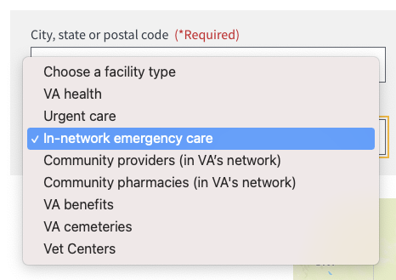
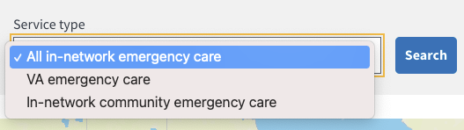
Background
Background & Goals
The current facility locator tool does not easily provide emergency care locations.
A new option "In-network emergency care" was tested under the 'Facility type' search dropdown.
Subsequent search options were tested under the 'Service type' dropdown:
All in-network emergency care
VA emergency care
In-network community emergency care

Slide 4
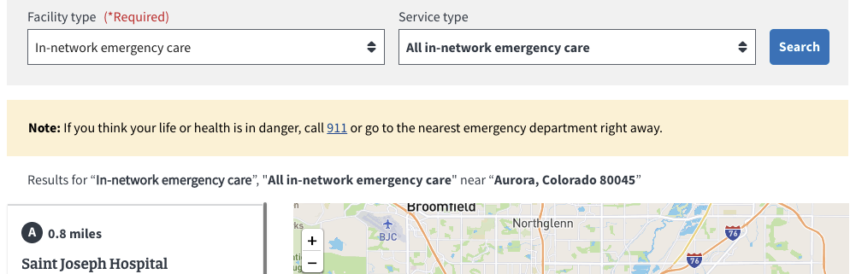
Background
Background & Goals
Additionally, an information alert associated with all emergency search options was also tested.

Slide 5
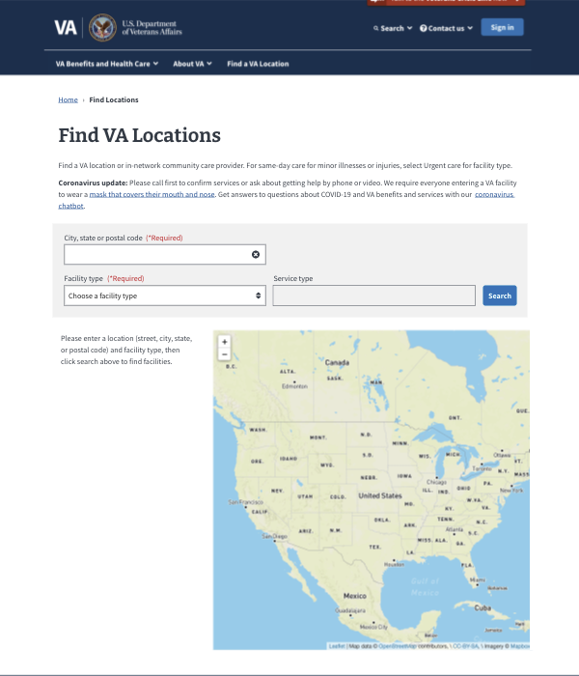
Research goals
Background & Goals
We conducted this research as part of the ongoing process to create a single source of truth for finding Veteran facing VA facilities. The goal of this study is to validate the usability and design of the new facility locator emergency care search options and results:
Participants to understand all of the emergency care facility options available to them
Validate that the design sufficiently informs participants about community care emergency benefits
Participants to understand what "in-network" means in terms of VA and non-VA community partners

Slide 6
Research questions
Methodology
What information do Veterans need/want from the Facility Locator search results when seeking emergency care?
What information do Veterans need/want for community emergency care (in VA network) locations?
Can Veterans distinguish between these location types in a single list?
Do Veterans understand that there are more locations available, than are present in the "in-network" results list?
Would Veterans click to learn more about community emergency care benefits?
What information does a Veteran find helpful in preparing to go to a emergency care facility?

Slide 7
Hypotheses to be tested
Background & Goals
Veterans want to search for a single list, containing both VA and community emergency care options.
Veterans understand they can go to any local emergency room, not just those in the results list.
Veterans understand that the Facility Locator list contains "in-network" VA and community care facilities, and is not comprehensive: it may not represent all emergency options available to them.
The facility type label "In-network emergency care" does not introduce confusion about other facility types.
Veterans understand how to learn more about community care emergency benefit (explained elsewhere).
Veterans will understand what to do in case of emergency.

Slide 8
Methodology

Slide 9
Method: Qualitative interviews
Methodology
Qualitative Interviews explore the views, experiences, beliefs and/or motivations of individuals on specific matters. Qualitative methods, such as interviews, often provide a 'deeper' understanding of behaviors, including the “why,” than would be obtained from purely quantitative methods.
A remote, via Zoom, moderated task-based usability study was conducted between May 17th - May 25th, 2021, with note-takers and observers also in attendance.
Participants were given an open-ended search task, and asked to describe their thought process, and to point out anything they felt was significant.
After the open-ended search task, I asked questions about specific search options and elements on the facility locator page.

Slide 10
Who we spoke with
Methodology
9 participants (of 15 scheduled)
8 Veterans, 1 caregiver
1 with identified cognitive disabilities
Ethnicities:
2 Hispanic, Latino, or Spanish Origin
6 White or Caucasian
1 unknown
Rural vs urban:
3 urban
6 rural participants
Genders:
1 transgender
6 male
2 female
Age ranges:
4 aged 35 - 44
3 aged 55 - 64
1 aged 65 - 74
1 aged unknown

Slide 11
Findings - Research Questions

Slide 12
1. What information do Veterans need/want from the Facility Locator search results when seeking emergency care?
Research Findings - Research Questions
When seeking emergency care, most participants expressed a desire for information about services offered, to see the closest available facilities, and easy access to information about their benefits.
Two participants suggested a specific change to search results:
[P1] "There should be an option that says, 'learn more about what the facility offers'...click on that to learn more."
[P6] "It would be nice to have something to each with the services offered to be hyper linked to each one."

Slide 13
2. What information do Veterans need/want for community emergency care (in VA network) locations?
Research Findings - Research Questions
When seeking emergency care at community partners, participants wanted easily accessible benefits information, and a clearer explanation of the process of claiming those benefits.
[P5] "I did not know what was expected me, and I don't think the website [in general] addresses that."
[P2] "Sometimes I don't know what to tell non-VA centers except to bill it through Tricare."

Slide 14
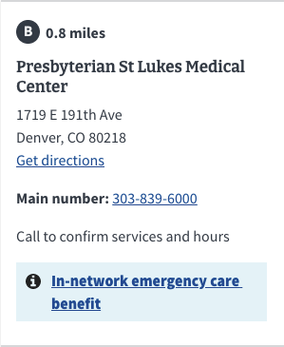
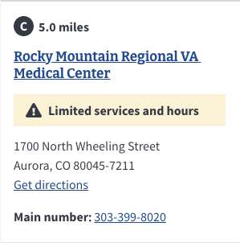
3. Can Veterans distinguish between these location types in a single list?
Research Findings - Research Questions
It was unclear if most participants were able to quickly distinguish between VA locations and community partners in the results list.
[P4] "I don't know why two of the results have [blue info alert] and the other two don't...I just realized the bottom two are VA."
[P11] "It also says that the top two are in-network...if I were too far from a VA hospital then I could go to one of [these]."

Slide 15
4. Do Veterans understand that there are more locations available, than are present in the "in-network" results list?
Research Findings - Research Questions
Most participants understood that search results only included in-network locations, and one participant expressed a desire for explicitly out-of-network locations in search results.
[P2] "If I am on a VA website, it is anything that is covered by the government...not including third party facilities."
[P4] "It's weird there is only an in-network emergency care and not also out-of-network emergency care"

Slide 16
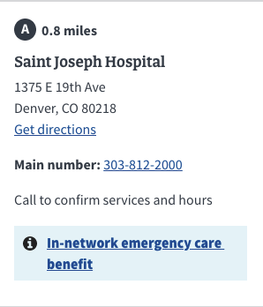
5. Would Veterans click to learn more about community emergency care benefits?
Research Findings - Research Questions
Most participants did not click to learn more about community care benefits. Most noticed the alert, but did not seem to recognize it as access to additional information.
[P10] "I just thought it was information, nothing that would give me [more] information"

Slide 17
6. What information does a Veteran find helpful in preparing to go to a emergency care facility?
Research Findings - Research Questions
When planning for future visits to emergency facilities, participants wanted a clear understanding of services offered, easy access to information about their benefits, and distance to the closest location. Two participants suggested having reviews associated with search results.
[P5] "I would suggest having reviews of the facilities...maybe pros and cons. VA emergency care is an oxymoron, give me a break."
[P4] "I would do a quick search for review...I would rather go to a civilian hospital...normally better care."

Slide 18
Findings - Hypotheses

Slide 19
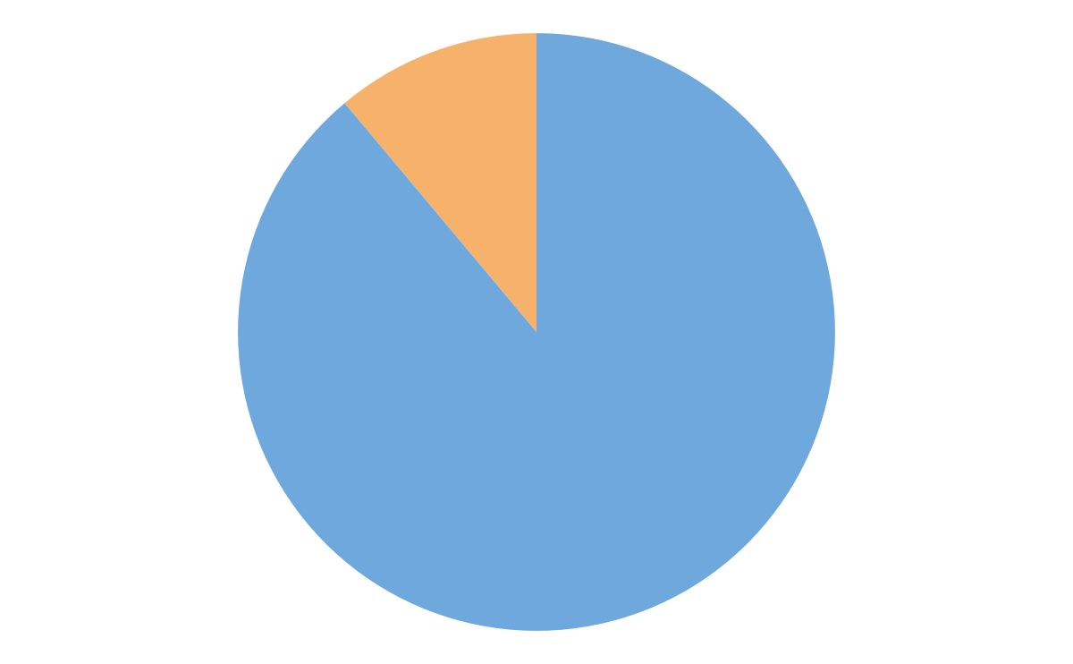
1. Veterans want to search for a single list, containing both VA and community emergency care options
Research Findings - Hypotheses
True: most participants chose "All in-network" before other options, and seemed to prefer a list that was inclusive of as many results as possible.
8/9 participants expressed this in some way during our conversations/testing.
[P10] “It puts all the information right here, that is good."

Slide 20
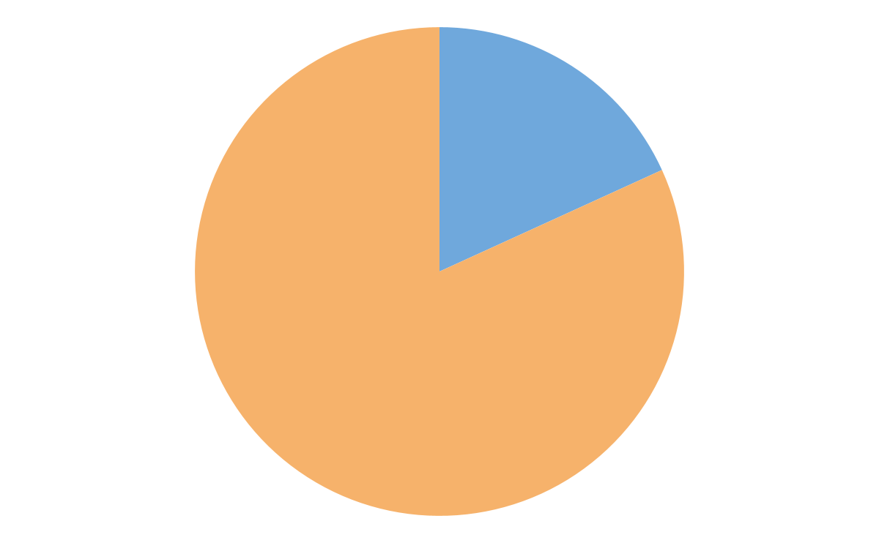
2. Veterans understand they can go to any local emergency room, not just those in the results list.
Research Findings - Hypotheses
False: most participants either didn’t notice, or did not feel the need to point the emergency alert, which indicates that Veterans should go to any available emergency room.
2/9 participants pointed out the emergency alert.
[P6] "[Pointing out alert] Common sense, if you have an emergency, call 911."

Slide 21
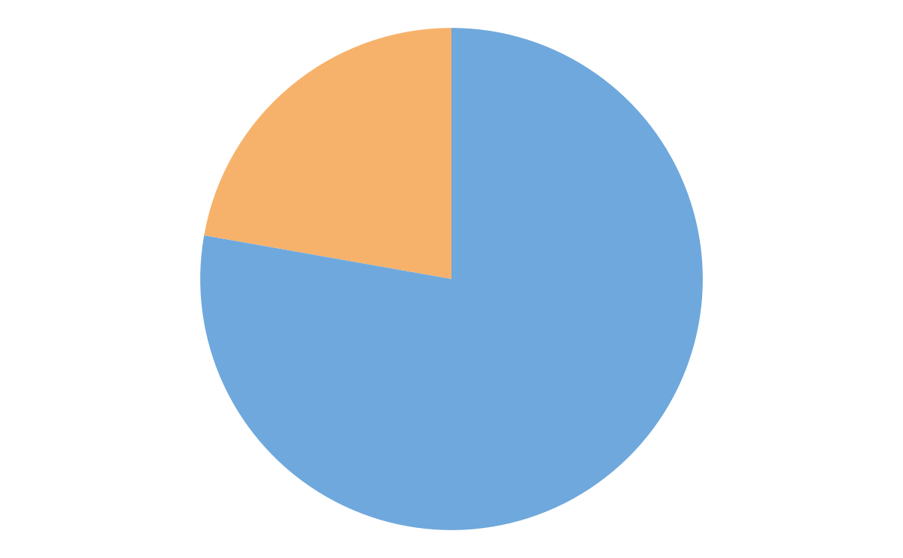
3. Veterans understand that the Facility Locator list contains "in-network" VA and community care facilities, and is not comprehensive: it may not represent all emergency options available to them.
Research Findings - Hypotheses
True: most participants knew search results were in-network only, and did not necessarily expect out-of-network search results.
7/9 participants expressed understanding that “in-network” referred only to VA or VA community partners.
[P2] "If I am on a VA website, it is anything that is covered by the government...not including third party facilities."

Slide 22
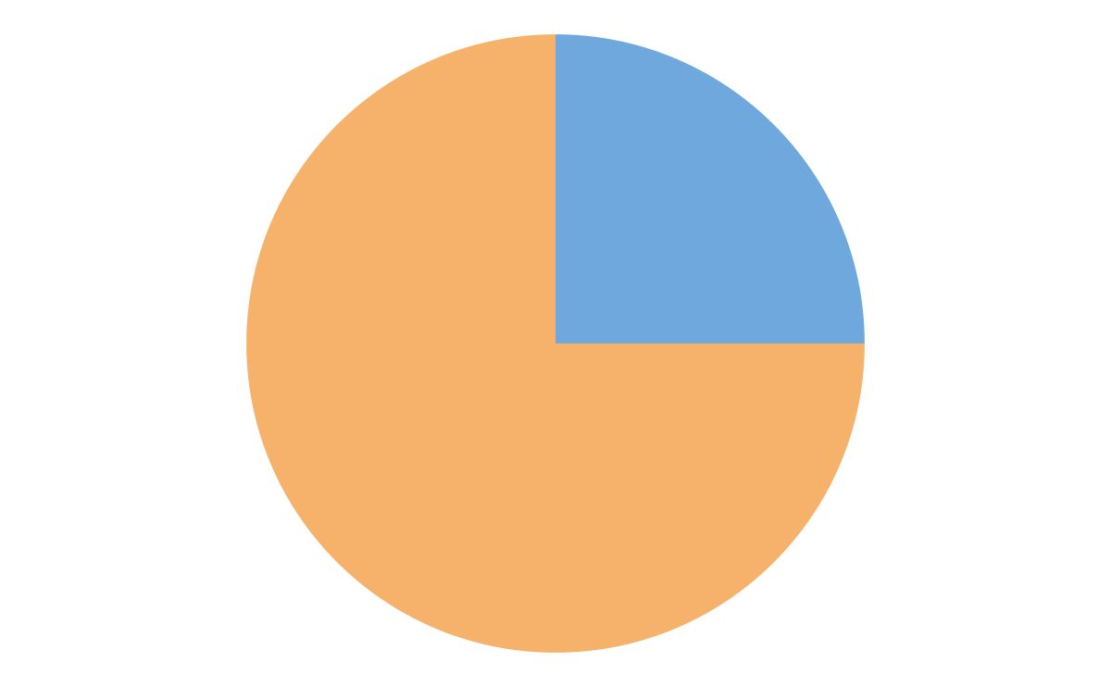
4. The facility type label "In-network emergency care" does not introduce confusion about other facility types
Research Findings - Hypotheses
False: this label did introduce confusion. Juxtaposed with the other ‘Facility type’ options, some participants suggested changing it to be similar to other options.
3/9 participants expressed confusion about facility types.
[P5] "...in-network emergency care, to me that is a stumbling block...I would want to hit emergency care, then have the explanation.”

Slide 23
5. Veterans understand how to learn more about community care emergency benefits
Research Findings - Hypotheses
False: most participants did not intuitively recognize the blue info alert as access to additional information, or were simply unwilling to click it during the demo.
2/9 participants participants clicked on the benefits link in search results.
[P1] "How would I learn more about my benefits and the types of care that a facility offers...I don't see a way to do that."

Slide 24
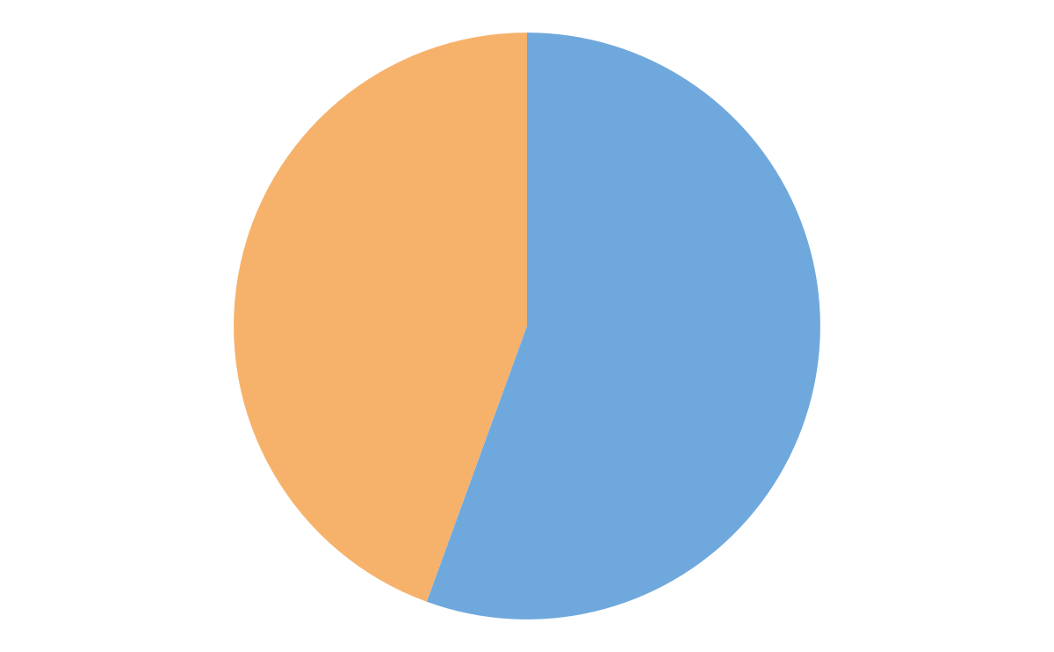
6. Participants will understand what to do in case of emergency.
Research Findings - Hypotheses
Mostly false: this was not gleaned from search results, however participants knew this from previous personal experience.
5/9 participants referenced previous experience as a source of information.
[P2] "...ER is still covered 100%...even if I'm not able to get to the VA."

Slide 25
Additional Insights

Slide 26
Additional Insights
Research Findings
Most participant's first choice during the open-ended search task was "Urgent Care" under the "Facility type" dropdown (5/9 participants)
"VA Health" under the "Facility type" dropdown was the second most picked first-choice option (3/9 participants)
For most participants, the main distinction between "urgent" and "emergency" seemed to be non-life threatening out-patient emergencies, vs potentially life-threatening in-patient emergencies.
[P1] "Urgent care means you need care in that moment, but it's not a matter of life or death. Emergency care is a matter of life or death."
[P2] "I think the fine line difference is whether it's life or death."
Of the participants that pointed out the yellow emergency alert, one stated that the blue info alert in the search results caught her attention first.
[P5] "...it's fine, but the blue caught my eye faster."

Slide 27
Recommendations

Slide 28
Recommendations
Change "In-network emergency care" under Facility type, to "Emergency care"
Veterans can still choose explicitly in-network options under the ‘Service type’ dropdown, so this should remove any confusion about the difference between this and other ‘Facility type’ options.
Consider revising the language of the benefits info alert
Most participants did not recognize the link as access to additional information, so using more explicit language may make it more recognizable as a call to action.
Ex: “Learn about your in-network emergency care benefits”
Consider changing the color & style of the emergency alert
Very few participants seemed to notice the yellow emergency alert. Changing its color, and/or updating the style of the alert component used in this instance, may increase engagement.

Slide 29
Next Steps

Slide 30
Next Steps
Design Iteration
Collaborate with Content team
Work with the Content team to determine best language for benefits alert
UX update
Change “In-network emergency care” to “Emergency care” in dropdown menu
Update content of benefits alert for both Emergency and Urgent care search results
Use Design System to choose more effective emergency alert component style
Initiate collab cycle and Platform Team review for any changes that will be reflected at component level
Engineering
Back-end integration w/PPMS
Front-end implementation of design
Business
Finalize key success metrics

Slide 31
Questions?

Slide 32
Detailed Findings

Slide 33
1. When seeking emergency care, participants wanted information about services offered, to see the closest available facilities, and easy access to information about their benefits.
Detailed Findings - Research Questions
Most participants fell into these three main categories of need. Two participants expressed desire for a direct link to services offered to be present in the search results.
[P1] "There should be an option that says, 'learn more about what the facility offers'...click on that to learn more."
[P6] "It would be nice to have something to each with the services offered to be hyper linked to each one."
Rural participants were particularly conscious of distance, and participants seemed more willing to visit whichever locations was closest, even if it was not in VA’s network.
[P4] "If I need emergency care then I may be willing to go somewhere that is out of network."
[P10] "I live further away from the facilities...I need to figure out which is the closest."
[P11] "If someone is in an emergency then they may want to go to the closest place regardless of [it being] in VA's network."
[P14] "I would look more at distance if it were an emergency."

Slide 34
2. When seeking emergency care at community partners, participants wanted easily accessible benefits information, and a clearer explanation of the process of claiming those benefits.
Detailed Findings - Research Questions
Nearly all participants expressed frustration with the process of validating their benefits at community partners.
[P2] "Sometimes I don't know what to tell non-VA centers except to bill it through Tricare."
[P5] "I did not know what was expected me, and I don't think the website [in general] addresses that."
Some participants also expressed a desire for direct link to benefits information to be present in search results.
[P6] "I would like a link here, 'in-network emergency care benefits'
[P1] "How would I learn more about my benefits...I don't see a way to do that."

Slide 35
3. It was unclear if most participants were able to quickly distinguish between VA locations and community partners in the results list.
Detailed Findings - Research Questions
Some participants did note the distinction, and based it on the presence of the blue info alert for community partners, and the presence of "VA" in the title of VA facilities.
[P4] "I don't know why two of the results have [blue info alert] and the other two don't...I just realized the bottom two are VA."
[P11] "It also says that the top two are in-network...if I were too far from a VA hospital then I could go to one of [these]."

Slide 36
4. Most participants understood that search results only included in-network locations.
Detailed Findings - Research Questions
Most participants seemed to realize that there were more locations available, and most understood “in-network” to mean only VA and VA partners.
[P2] "If I am on a VA website, it is anything that is covered by the government...not including third party facilities"
One participant expressed an explicit desire to have out-of-network results in the search list.
[P4] "It's weird there is only an in-network emergency care and not also out-of-network emergency care"

Slide 37
5. Most participants did not click to learn more about community care benefits.
Detailed Findings - Research Questions
Most participants noticed the alert, but either did not intuitively recognize it as access to additional information, or were simply unwilling to click it during the demo. Only two participants clicked on the blue info alert present in search results.
[P1] "How would I learn more about my benefits and the types of care that a facility offers...I don't see a way to do that"
[P2] "...[referencing info alert] seems more like an information section...seem[s] like somewhere you can go to get more info."
[P6] "I would assume if I clicked here...any of those would [point] me towards the facility...looks easy to click the benefit link"
[P10] "I just thought it was information, nothing that would give me [more] information"

Slide 38
6. When planning for future visits to emergency facilities, participants wanted a clear understanding of services offered, easy access to information about their benefits, and distance to the closest location.
Detailed Findings - Research Questions
Most participants expressed similar desires to the question, “What information do Veterans need/want from the Facility Locator search results when seeking emergency care?”
Two participants expressed the desire to see the review of a facility before going there, noting that they had had better experiences at local community partners.
[P4] "I would do a quick search for review...I would rather go to a civilian hospital...normally better care."
[P5] "I would suggest having reviews of the facilities...maybe pros and cons. VA emergency care is an oxymoron, give me a break."

Slide 39
1. Veterans want to search for a single list, containing both VA and community emergency care options.
Detailed Findings - Hypotheses
True: most participants chose "All in-network" before other options, and seemed to prefer a list that was inclusive of as many results as possible.
[P10] "[looking at results] That's pretty good. I see in network stuff...then you get to the centers with limited services and hours like clinics here. It puts all the information right here, that is good."
Some noted the usefulness of the VA and VA community partners distinction, and two participants felt that "Service type" options were redundant.
[P6] "I don't know why I would exclude a VA facility...I don't know if I would go to the last one, because to get this info I would just click all in-network."
[P2] "It seems like it's redundant, but for a specific purpose - you may not get many results if you chose third [in-network community care] option."

Slide 40
2. Veterans understand they can go to any local emergency room, not just those in the results list
Detailed Findings - Hypotheses
False: most participants either didn’t notice, or did not feel the need to point the yellow emergency alert that appears with emergency care search results, which is currently the only thing that indicates that Veterans should go to any available emergency room. Only two participants pointed out the alert.
[P6] "[Pointing out alert] Common sense if you have an emergency, call 911."
[P5] "[referencing yellow alert]...it's fine, but the blue [benefits alert] caught my eye faster."

Slide 41
3. Veterans understand that the Facility Locator list contains "in-network" VA and community care facilities, and is not comprehensive: it may not represent all emergency options available to them.
Detailed Findings - Hypotheses
True: Most participants recognized "in-network" as meaning VA and VA community partners, and did not necessarily expect out-of-network locations in the search results.
[P2]"If I am on a VA website, it is anything that is covered by the government...not including third party facilities."
[P4] "I would assume that all results...would be in-network." & "If I'm on a VA website, I would want everything to be in-network unless I choose otherwise"
Two participants expressed confusion about the specific phrase “in-network”
[P5]"Does in-network mean Medicare and how does the VA dovetail?"
[P14] "I would probably be a little confused...Is it any VA facility choice program that will work with the VA?”

Slide 42
4. The facility type label "In-network emergency care" does not introduce confusion about other facility types.
Detailed Findings - Hypotheses
False: this label did introduce confusion. When juxtaposed with the other ‘Facility type’ dropdown options, which do not have the “in-network” label, some participants felt it was out of place, and suggested changing it to be similar to other options.
[P4] "I would change in-network [emergency care] to ER."
[P5] "...in-network emergency care, to me that is a stumbling block...I would want to hit emergency care, then have the explanation.”
The presence of “in-network” next to only one option under ‘Facility type’, gave one participant the impression that the options that did not have this label, were not necessarily VA or VA partners.
[P11] "[The ‘Urgent care’ option] would be any hospital, but they may or may not be VA affiliated."

Slide 43
5. Veterans understand how to learn more about community care emergency benefits.
Detailed Findings - Hypotheses
False: most participants did not intuitively recognize the blue info alert as access to additional information, or were simply unwilling to click it during the demo.
[P1] "How would I learn more about my benefits and the types of care that a facility offers...I don't see a way to do that."
One participant thought the alert was simply a notice associated with community partner search results.
[P11] "The blue info notice means I can go there...they will accept Veteran's insurance."
One of the two participants who clicked on the blue info alert, did not recognize it as clickable at first. After clicking, she did feel that the information on the benefits page was useful, and noted the “Notify VA Immediately” option as important.
[P10] "I just thought it was information, nothing that would give me [more] information…[and after clicking] ...It does have Vet information...that is perfect.”
[P10] "Some veterans don't know how fast the VA needs to know so it will be covered"

Slide 44
6. Participants will understand what to do in case of emergency.
Detailed Findings - Hypotheses
Mostly false: participants seemed to know this from previous experience, but not from anything in the search results that explicitly indicates this. Only two participants pointed out the emergency alert, but most expressed previous experience with emergency procedures.
[P4] "But if I go to a non-VA center then I'm supposed to call ahead to get approval...unless it's life or death."
[P2] "...ER is still covered 100%...even if I'm not able to get to the VA."
[P11] "I have a high disability rating so almost everything is covered."
[P5] "There are serious issues getting healthcare from the VAs under emergency circumstances [as a result of visiting any location]"
[P14] "I can always take him to the hospital, but there are issues..."

Slide 45
Appendix

Slide 46
Appendix Documents
Research Plan
Conversation Guide
Transcripts
Synthesis spreadsheet
UXPin Prototype

